Slide 1
Thesis Proposal - Behavioral Robustness of Software System Designs
Changjian Zhang

Slide 2
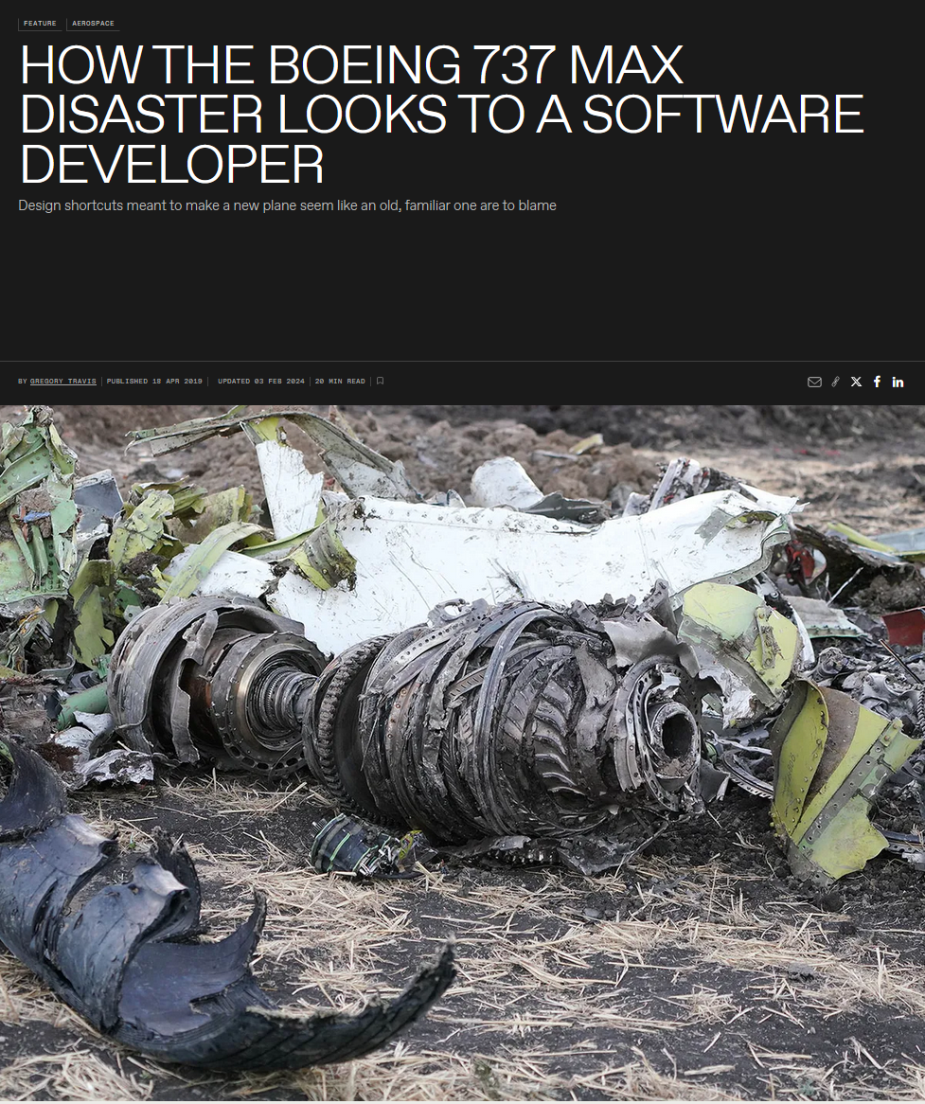
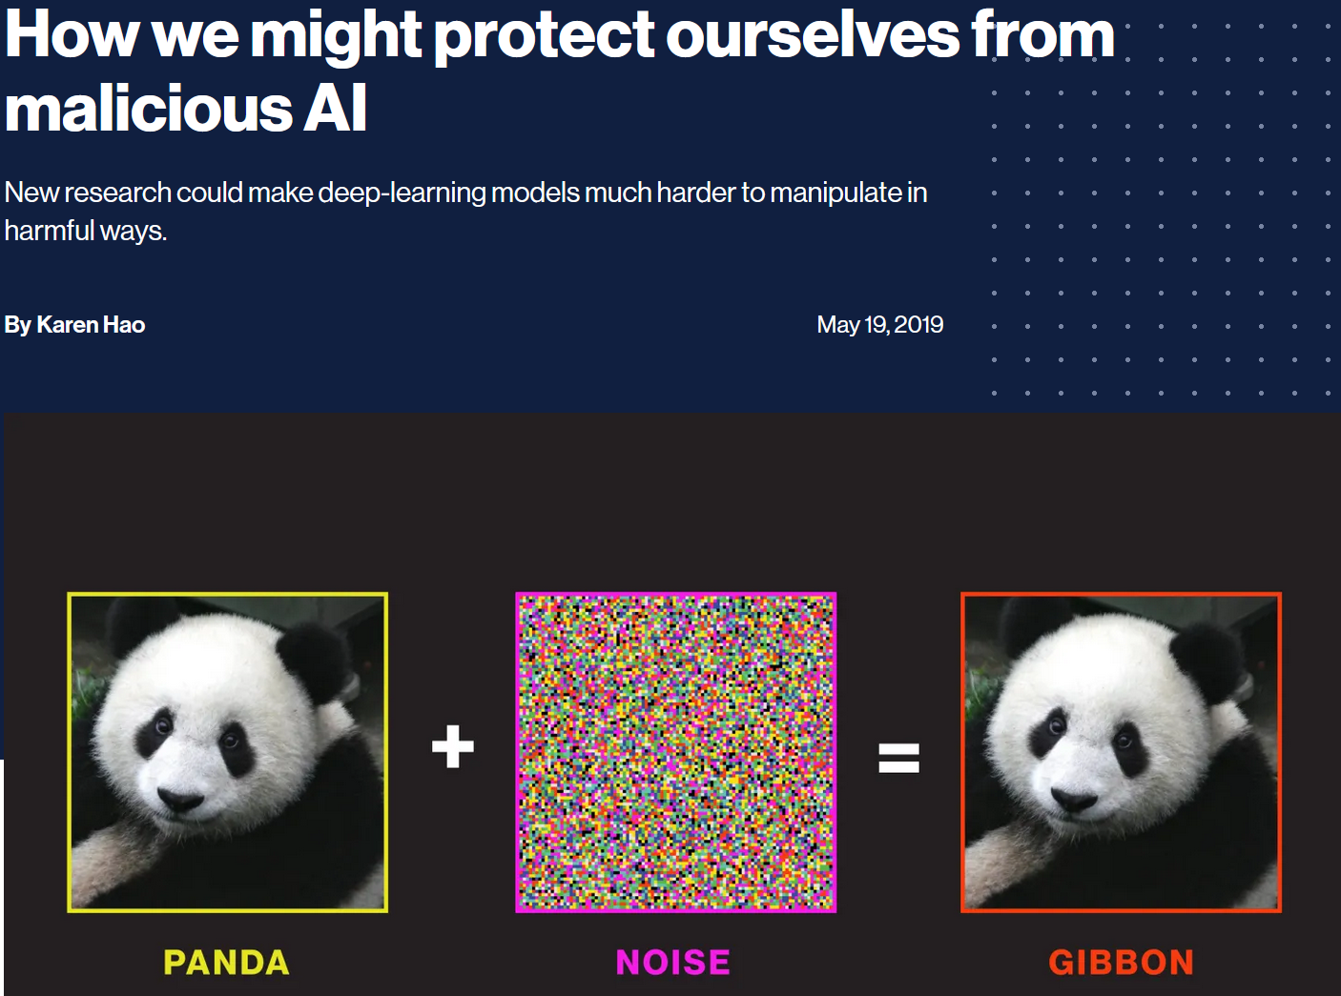
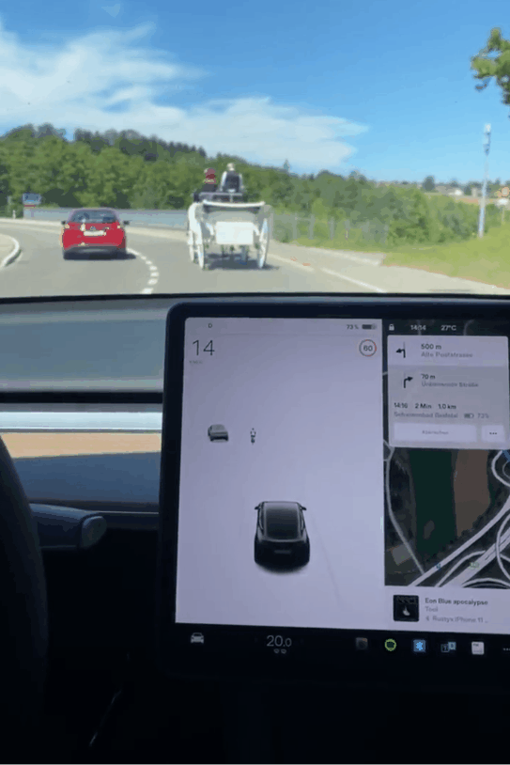

A Thesis about Software Robustness
“Robustness is the ability of a software system to continue functioning correctly in the presence of invalid inputs or stressful environment.”
Notes:
A thesis about robustness.
IEEE def..
News, easy to find…
E.g., the boeing accident where you may say the system is not robust against sensor errors and the conflicts between the pilots and flight control system.
E.g., in the winter of 2022, you may say the scheduling system of southwest airlines is not robust against winterstorm where there were a lot of flight cancellation.
In machine learning, we expect the model to be robust against noise or minor changes to the input.
Or in self-driving cars, you may expect the system to be robust against inaccurate output from the object detection, and the car can drive safely.
However, this is also hard, because robustness has different meanings under different domains. So the first step to define: what kind of robustness we are studying.

Slide 3
A Categorization of Robustness
Type of Systems
I/O Relation vs Behavioral
Conventional Software Systems:
Discrete systems.
OS, web services, etc.
Machine Learning (ML) Systems:
Data driven, statistical model.
Cyber-Physical Systems (CPS):
Physical process + Software.
Drones, self-driving cars.
Input-Output Relations:
No erroneous outputs or crashes under invalid inputs (e.g., out-of-range values).
Behavior as States and Transitions:
Safety: not reaching bad states.
Liveness: reaching good states.
Maintain a property under unexpected env behavior.
Notes:
We consider there are two ways to classify robustness.
From the types of systems: first, we consider conventional systems, they can be captured as discrete systems, like …
Then, we consider machine learning systems, they are … often cannot be described as discrete systems.
Finally, we have CPS, other than the software component, you often have to model the physical process, like a drone, or self-driving cars.
In this work, we focus on conventional systems that can be modeled in discrete systems.
Then, another way of classification is the types of properties.
One common way is IO-relation, like, we say the system should not have erroneous outputs given some invalid inputs, like out-of-range values, or noise, or adversarial attacks in a ML context.
Another way is considering behavior as states and transitions. In this case, we often consider two types of correctness: safety (..) and liveness (…)
Then, robustness is that the system should maintain a desired safety/liveness, under unexpected env beh.
In this work, we focus on this type of behavioral robust.
Should mention type of CPS/.

Slide 4
Software Behavioral Robustness
System
Machine
Assumed
Env.
satisfy
Safety/Liveness Property
Deviations: sequences of env events not defined.
satisfy?
Actual
Env.
Notes:
So we call this type of robustness: software behavioral robustness.
In particular, we consider a system is the composition of a machine and its operating env.
When we design and implement a system, we expect this composition to satisfy some safety/liveness property.
However, the actual env may be different from the assumed one, so robustness ask the question that whether the sys continue to satisfy the property under the actual env.
This difference may be referred as unexpected behavior, but in this work, we call them deviations. And we consider deviations as sequences of env events…

Slide 5



Robust-by-Design Software
Assessment: Methods to systematically measure robustness.
Design
Robustness
Analysis
Developer, Designer,
Architect
Improvement: Methods to systematically improve the robustness of a design.
Robustify
Design
Notes:
The goal of this robustness research is to achieve the robust-by-design software.
We consider an iterative process, where …
There are two important aspects to conduct this process:
How to measure robust
How to improve …
Then, do existing techniques support this process?

Slide 6
Gaps in Robustness Assessment
Existing works are mainly experimental focusing on testing:
Evaluating against a software implementation.
Methods: fault injection, model-based testing, fuzzing, …
More about Input-Output Relationships.
Limitations:
Implementation focus rather than design.
Focus on IO-robustness rather than behavioral robustness.
Find violations but cannot provide robustness guarantees.
RQ: Can we qualitatively/quantitatively measure behavioral robustness of a machine design?
Notes:
Existing works for robustness assessment mainly …
The limitations: first, they mostly focus on implementation whereas we want to achieve robust-by-design.
…

Slide 7
Gaps in Robustness Improvement
Improve robustness of an implementation by wrappers or by improving code quality:
Wrappers over existing components to filter invalid inputs and erroneous outputs.
Defensive programming, Clean Code, Effective Java, …
Limitations:
Implementation focus rather than design.
Lack a systematic view of improving design robustness against a safety/liveness property.
RQ: Can we rigorously and systematically improve the behavioral robustness of a machine design?
Notes:
The second limitation is that they lack a systematic view: like if we add a null-pointer checker in this function A, how does it improve the the robust of the entire system?

Slide 8
“Robustness” in Self-Adaptive Systems
Self-adaptive system: maintain machine functionalities and quality attributes at run time against uncertainties.
Improve “robustness”, implicitly or explicitly.
A broader set of properties: performance, availability, …
Focusing on run-time assurance.
This work learned from them, but focuses more on:
Robust measurement (quantify uncertainties).
Design time robustness improvement.
Notes:
Other than these works which have an explicit robust tag, it is also important to note works from self-adaptive system and runtime ensurance.
E.g., self-adaptive system: …
Based on this definition, this also improve software robustness but may not explicitly use the term.
Also, they focus on a broader set of properties: …
However, the difference is that, in our work:
…

Slide 9
Thesis Statement
Given a machine and its environment that can be formally modeled as a state-transition system, we can systematically measure and improve the behavioral robustness of the machine with respect to the environment and a system-level safety property.
Notes:
So Finally, we can introduce my thesis statement: …

Slide 10
Behavioral Robustness of Conventional Software Systems
We study:
Conventional software systems modeled in discrete systems.
(Closed) System = Machine + Environment.
Behavior: sequences of states and transitions.
Behavioral property: safety property (not reaching bad states).
Unexpected behavior (deviations): sequences of environmental events not in the assumed environment.
Robustness: the capability of a machine to maintain a safety property under unexpected sequences of events from its actual environment that are not defined in the assumed environment.
Notes:
To elaborate on that, in this work, we study:

Slide 11
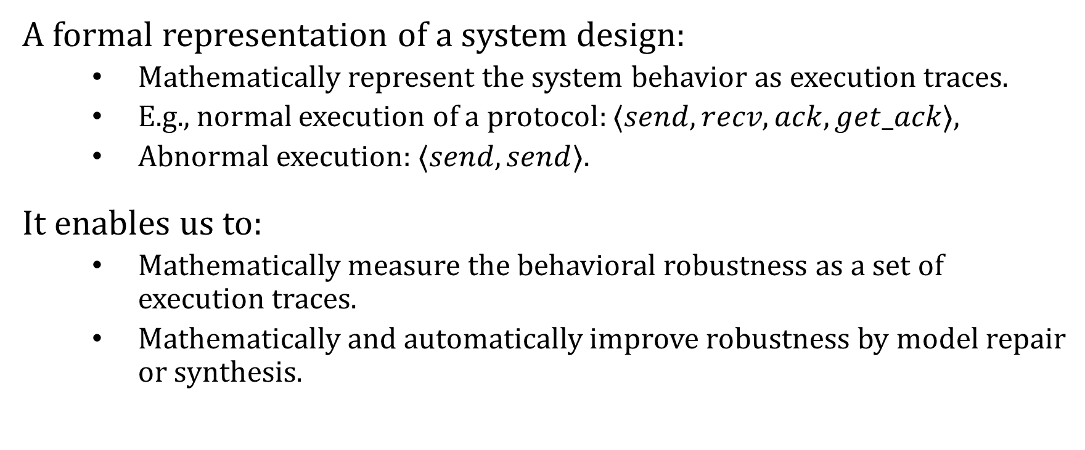
Rigorous and Systematic Reasoning by Formal Methods
A formal representation of a system design:
Mathematically represent the system behavior as execution traces.
E.g., normal execution of a protocol: $⟨send, recv, ack,get_ack⟩$,
Abnormal execution: $⟨send, send⟩$.
It enables us to:
Mathematically measure the behavioral robustness as a set of execution traces.
Mathematically and automatically improve robustness by model repair or synthesis.

Slide 12
Contributions Overview
Contrib. 3: Implemented in a tool, Fortis, and evaluated against 5 case studies.
Fortis
Formalism: Labeled Transition System (LTS)
Design
Robustness
Analysis
Contrib. 1: A behavioral notion of robustness based on LTS and its computation method.
Developer, Designer,
Architect
Contrib. 2: Improve behavioral robustness automatically by wrapper and specification weakening.
Robustify
Design

Slide 13
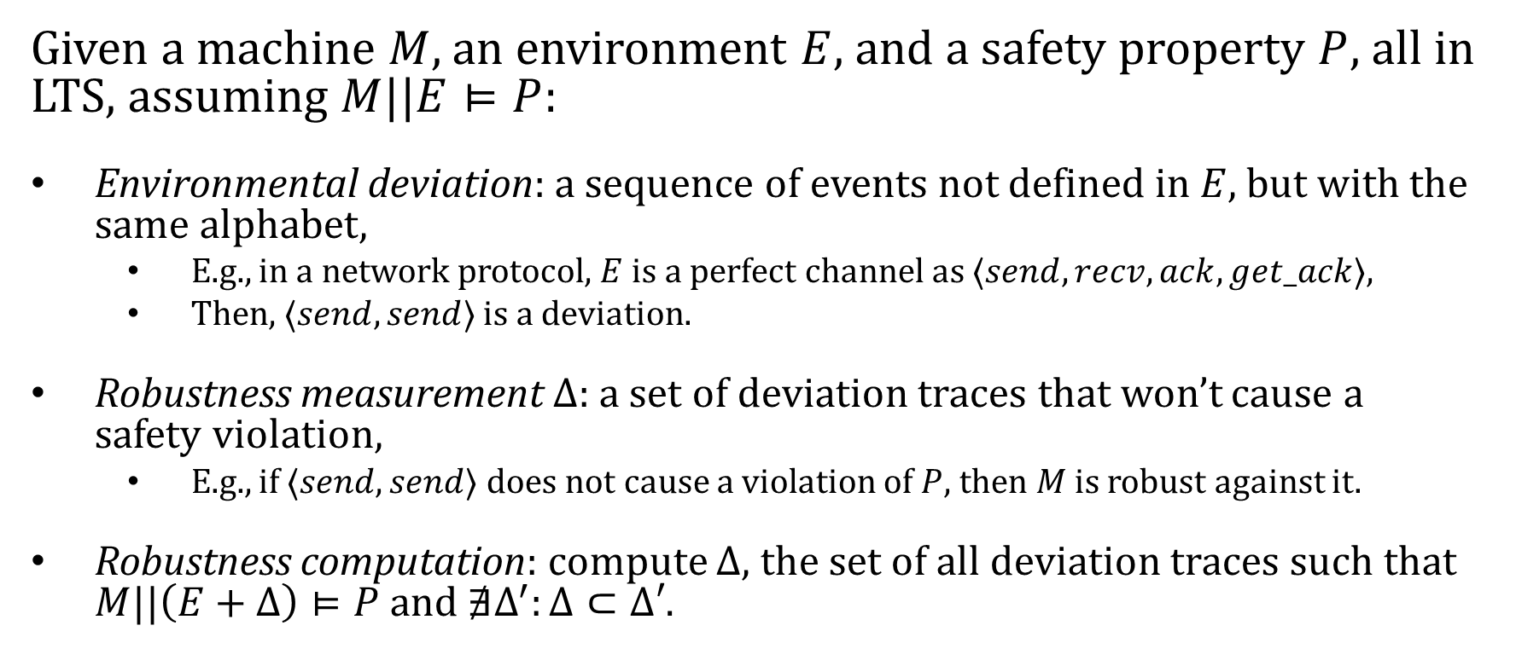
Contrib. 1: Robustness Analysis
Given a machine $M$, an environment $E$, and a safety property $P$, all in LTS, assuming $M||E⊨P$:
Environmental deviation: a sequence of events not defined in $E$, but with the same alphabet,
E.g., in a network protocol, $E$ is a perfect channel as $⟨send,recv,ack,get_ack⟩$,
Then, $⟨send,send⟩$ is a deviation.
Robustness measurement $Δ$: a set of deviation traces that won’t cause a safety violation,
E.g., if $⟨send,send⟩$ does not cause a violation of $P$, then $M$ is robust against it.
Robustness computation: compute $Δ$, the set of all deviation traces such that $M||\left(E+Δ\right)⊨P$ and $∄Δ^{′}:Δ⊂Δ′$.

Slide 14
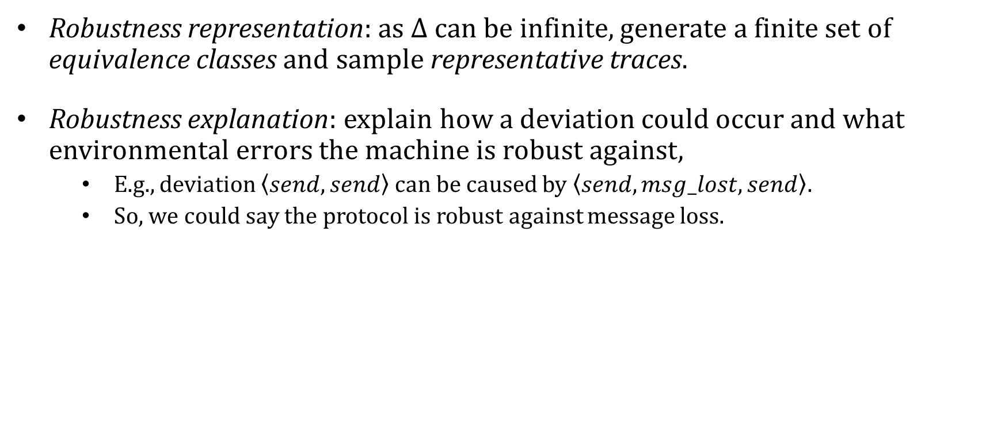
Robustness Analysis
Robustness representation: as $Δ$ can be infinite, generate a finite set of equivalence classes and sample representative traces.
Robustness explanation: explain how a deviation could occur and what environmental errors the machine is robust against,
E.g., deviation $\left\langle send,send\right\rangle$ can be caused by $\left\langle send,msg_lost,send\right\rangle$.
So, we could say the protocol is robust against message loss.

Slide 15
Contrib. 2: Design Robustification
Safety
Liveness
Observability
Controllability
Cost
Safety can be achieved by disabling actions.
But it hurts liveness (e.g., a machine that does nothing).
Increasing observability and controllability allows finer-grained control.
But it demands more cost of implementation.

Slide 16
Contrib. 2a: Robustification by Wrapper
Safety
Preferred Scenarios
Observability
Controllability
Cost
Key tactic: monitor and disable events to ensure safety.
Liveness: a set of preferred scenarios.
Obsrv./Ctrl.: a set of observable and controllable events.
Cost: cost associated with implementing the events.
Solve a multi-objective optimization:
Retain liveness,
Minimize cost.
Notes:
Liveness is a bit confusing.
Arrows are confusing.

Slide 17
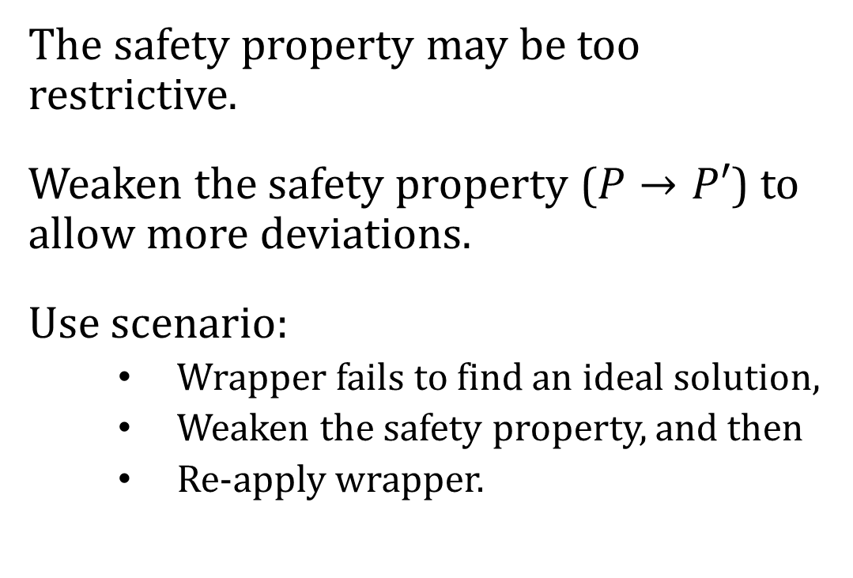
Contrib. 2b: Robustification by Specification Weakening
Safety
Liveness
Observability
Controllability
Cost
The safety property may be too restrictive.
Weaken the safety property ($P→P′$) to allow more deviations.
Use scenario:
Wrapper fails to find an ideal solution,
Weaken the safety property, and then
Re-apply wrapper.
Notes:
Add the arrows back to the other dimensions.

Slide 18
Research Scope
We do not consider:
ML and CPS: requires significant changes in formalisms and approaches, e.g., probabilistic models and statistical model checking.
Other types of uncertainties: unknown events, the probability associated to an event, etc.
Liveness: requires significant different approaches, e.g., demanding adding retries for a protocol.
Evaluation of the tool, Fortis, w.r.t. other quality attributes such as usability and extensibility.

Slide 19
Progress and Plan
 | Description | Est. Time Remains
Must-Haves | A behavioral notion of software robustness based on LTS. | Completed
 | The computation of robustness w.r.t. safety properties | Completed
 | Robustification by wrapper. | Completed
 | Robustification by specification weakening. | 3 months
May-Haves | Evaluation over a large-scale, real-world system. | 3+ months
 | Improving and evaluating the quality of Fortis. | 2+ months
Won’t-Haves | Robustness w.r.t. liveness properties. | N/A
 | Robustness w.r.t. ML systems or CPS. | N/A

Slide 20
Robustness Analysis
A behavioral notion of robustness.
Robustness computation and representation.

Slide 21
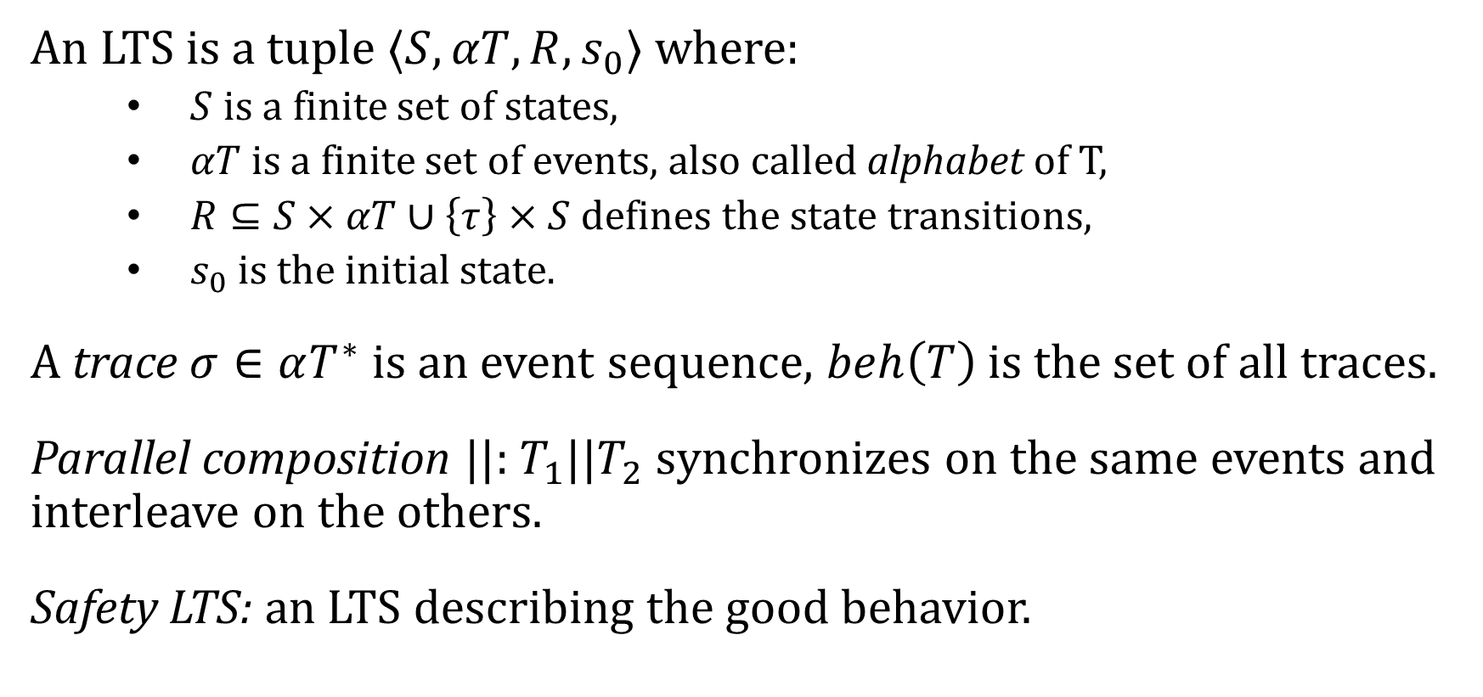
Labeled Transition System
An LTS is a tuple $⟨S,αT,R,s_{0}⟩$ where:
$S$ is a finite set of states,
$αT$ is a finite set of events, also called alphabet of T,
$R⊆S×αT∪\left\{τ\right\}×S$ defines the state transitions,
$s_{0}$ is the initial state.
A trace $σ∈αT^{∗}$ is an event sequence, $beh\left(T\right)$ is the set of all traces.
Parallel composition $||$: $T_{1}||T_{2}$ synchronizes on the same events and interleave on the others.
Safety LTS: an LTS describing the good behavior.

Slide 22
Motivating Example: Therac-25

Slide 23
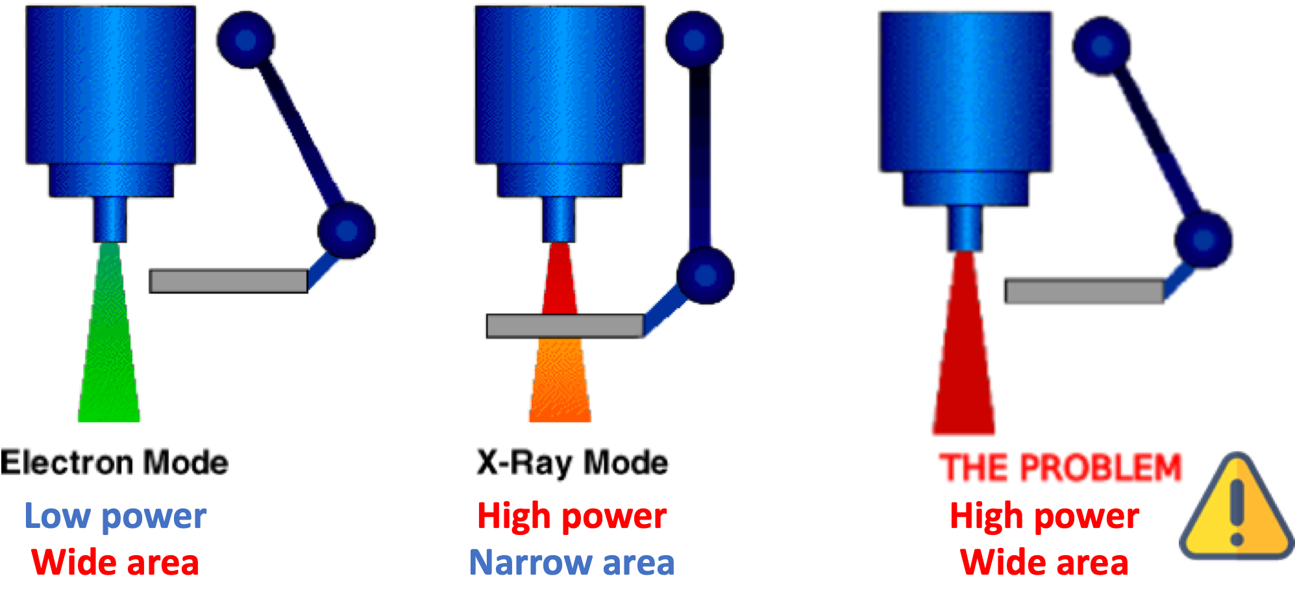
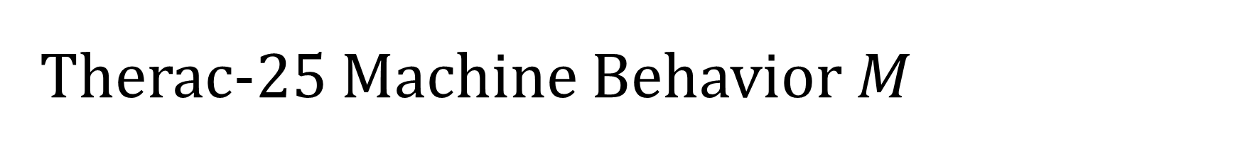
Therac-25 Machine Behavior $M$
A spreader in place during X-Ray for safe radiation level.
Electron (EBeam) and X-Ray modes.

Slide 24
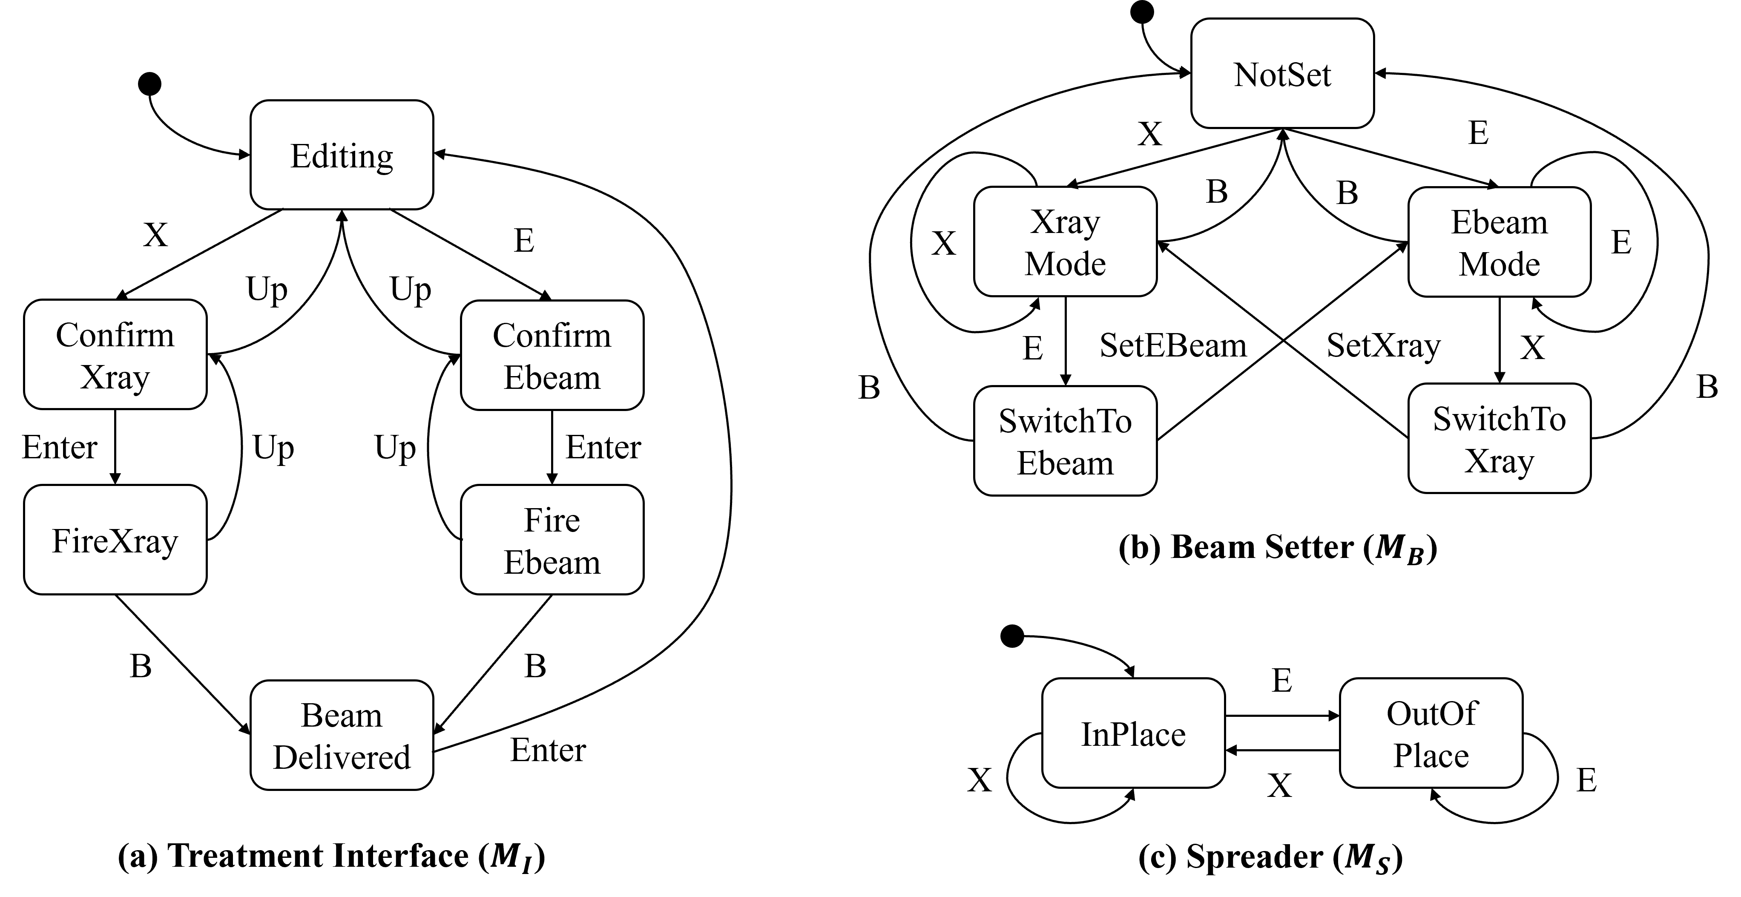
Formal Models of Therac-25

Slide 25
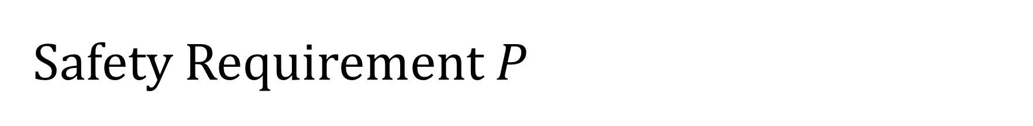
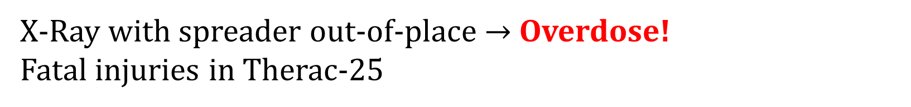
Safety Requirement $P$
X-Ray with spreader out-of-place $→$ Overdose!
Fatal injuries in Therac-25

Slide 26
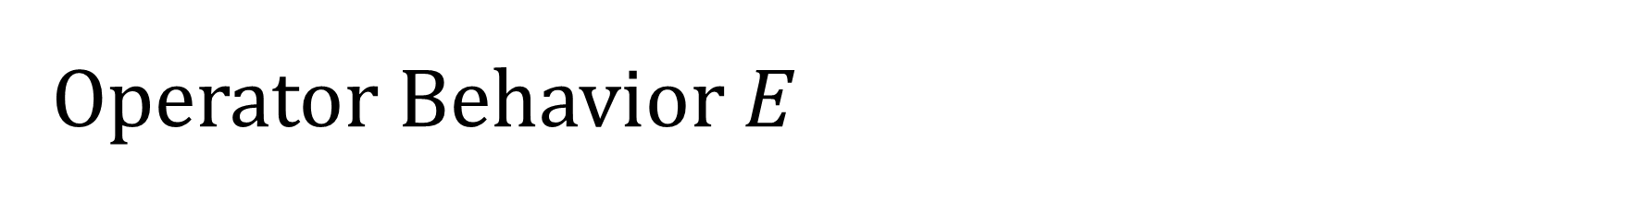
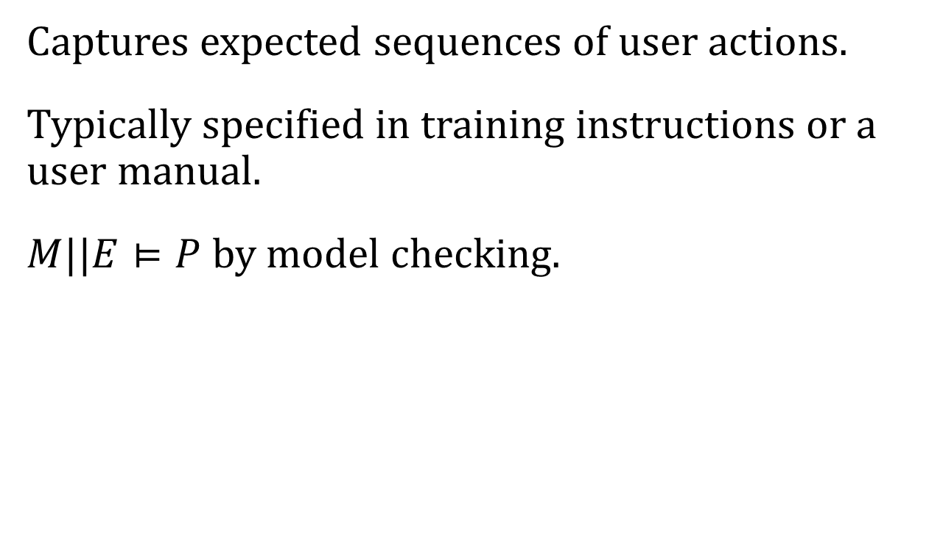
Operator Behavior $E$
Select Mode
Captures expected sequences of user actions.
Typically specified in training instructions or a user manual.
$M||E⊨P$ by model checking.
X
E
Confirm Mode
Enter
Fire Beam
B
Task Complete
Notes:
Our assumption is that, the machine should satisfy the desired property given the assumed env.

Slide 27
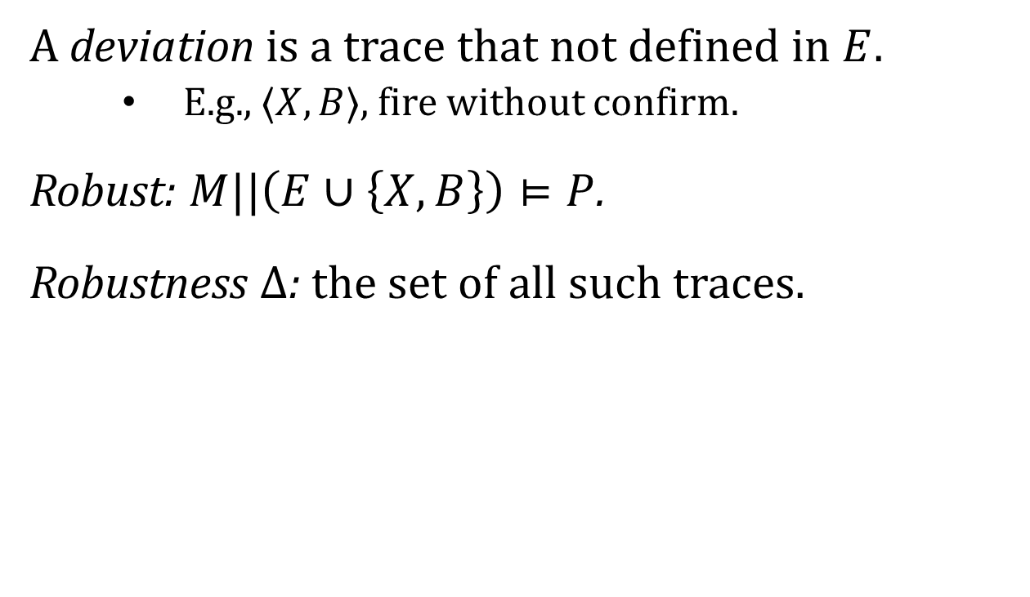
Deviation and Robustness
Select Mode
A deviation is a trace that not defined in $E$.
E.g., $⟨X,B⟩$, fire without confirm.
Robust: $M||\left(E∪\left\{X,B\right\}\right)⊨P$.
Robustness $Δ$: the set of all such traces.
X
E
Confirm Mode
Enter
Fire Beam
B
B
Task Complete

Slide 28
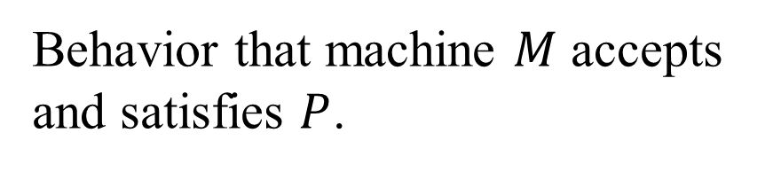
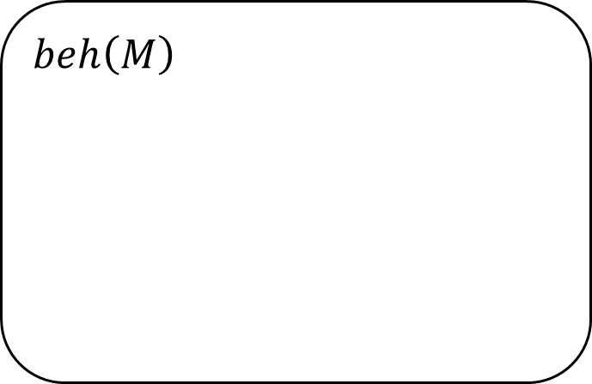
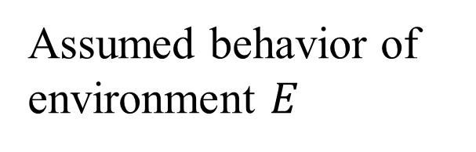
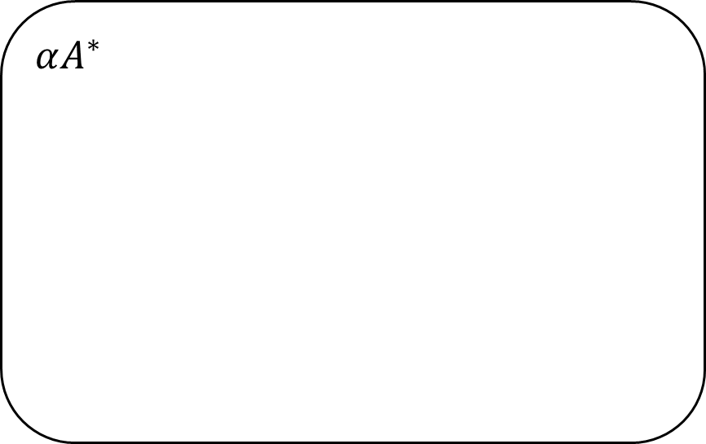
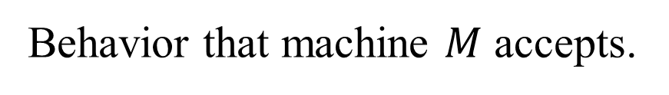
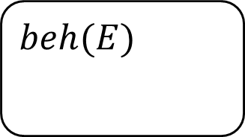
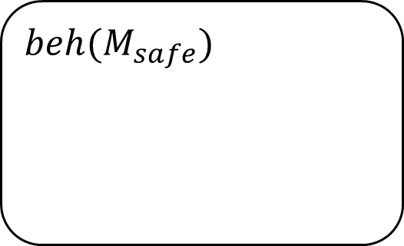
Robustness Computation
$$αA^{∗}$$
Behavior that machine $M$ accepts.
$$beh\left(M\right)$$
$$beh(M_{safe})$$
Behavior that machine $M$ accepts and satisfies $P$.
$$beh(E)$$
Assumed behavior of environment $E$

Slide 29
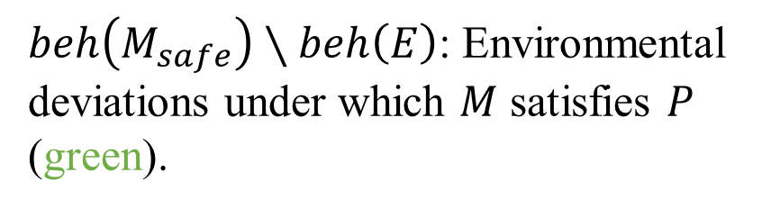
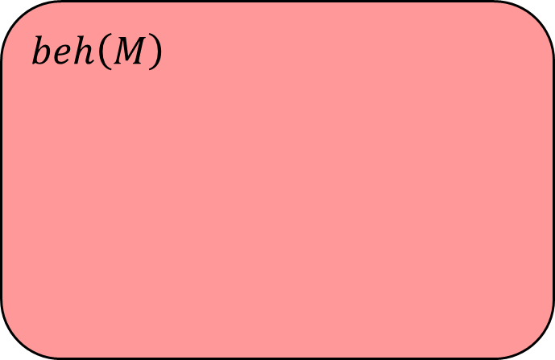
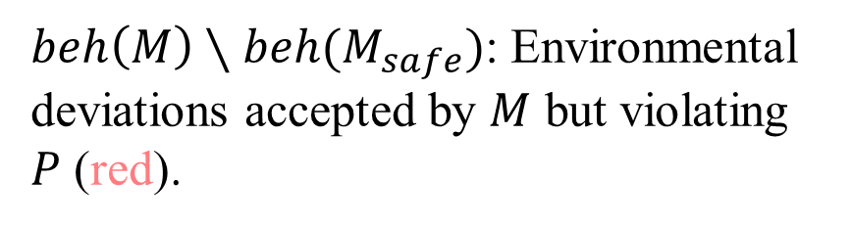
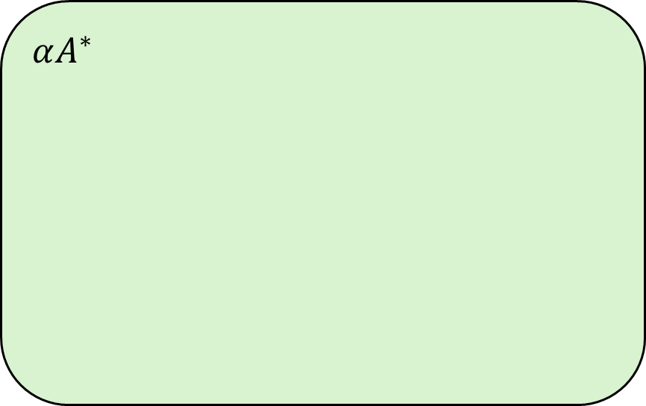
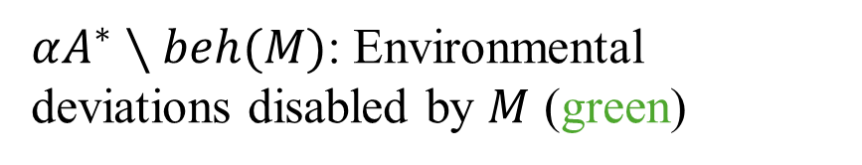
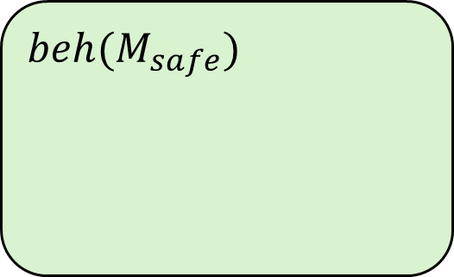
Robustness Computation
$αA^{∗}∖beh(M)$: Environmental deviations disabled by $M$ (green)
$$αA^{∗}$$
$$beh\left(M\right)$$
$beh\left(M\right)∖beh(M_{safe})$: Environmental deviations accepted by $M$ but violating $P$ (red).
$$beh(M_{safe})$$
$$beh(E)$$
$beh\left(M_{safe}\right)∖beh\left(E\right)$: Environmental deviations under which $M$ satisfies $P$ (green).

Slide 30
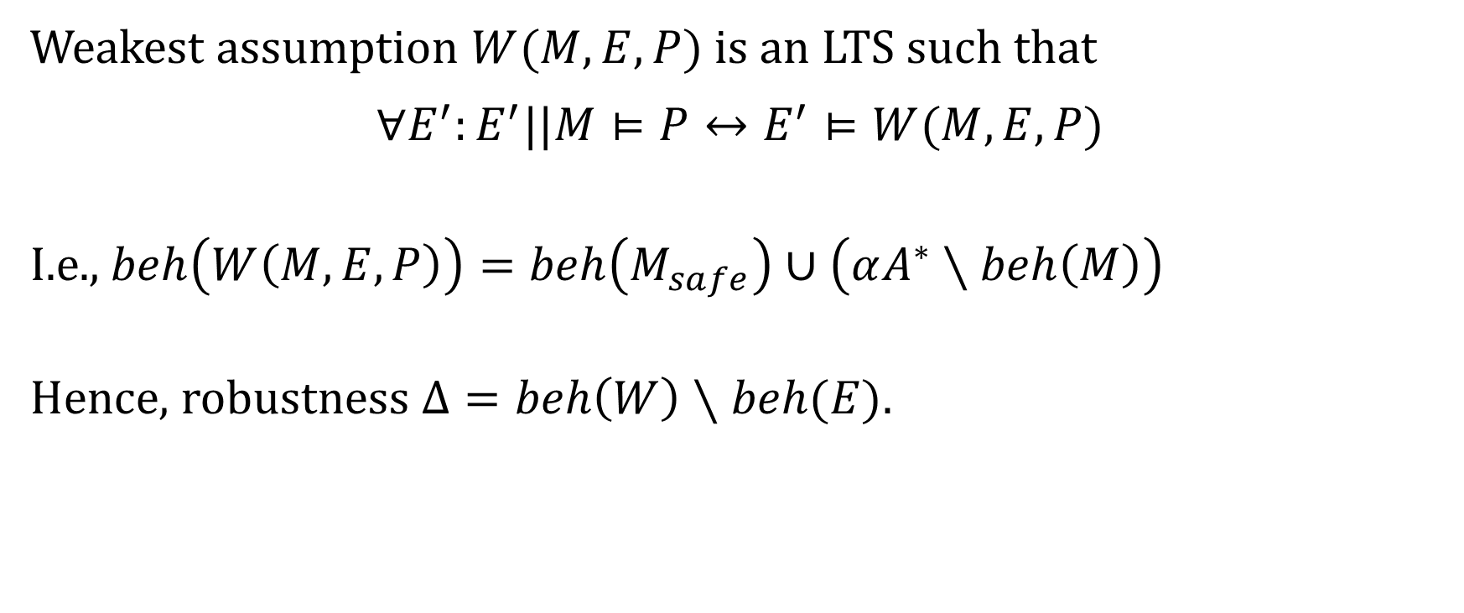
Robustness and Weakest Assumption
Weakest assumption $W(M,E,P)$ is an LTS such that
$$∀E^{′}:E^{′}||M⊨P↔E^{′}⊨W(M,E,P)$$
I.e., $beh\left(W\left(M,E,P\right)\right)=beh\left(M_{safe}\right)∪\left(αA^{∗}∖beh\left(M\right)\right)$
Hence, robustness $Δ=beh\left(W\right)∖beh(E)$.

Slide 31
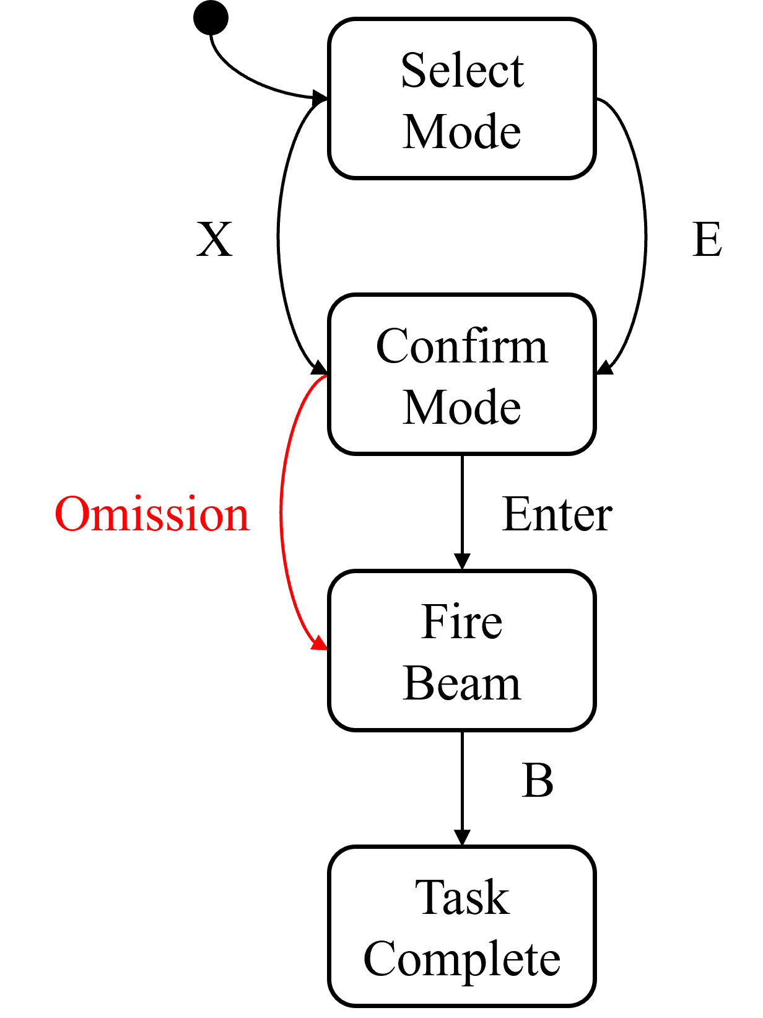
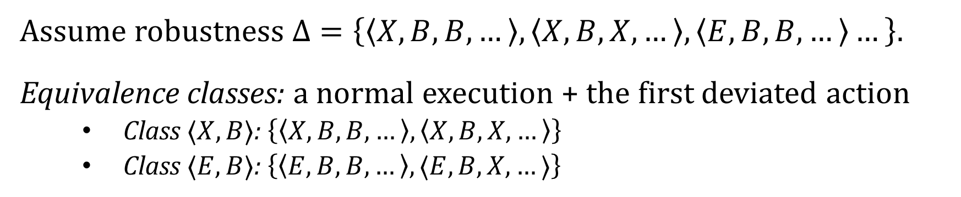
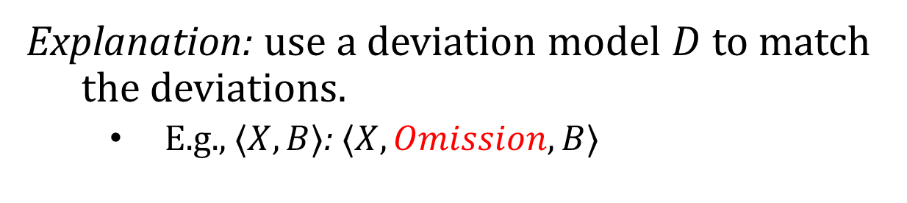
Robustness Representation and Explanation
Assume robustness $Δ=\left\{\left\langle X,B,B,…\right\rangle ,\left\langle X,B,X,…\right\rangle ,\left\langle E,B,B,…\right\rangle …\right\}$.
Equivalence classes: a normal execution + the first deviated action
Class $⟨X,B⟩$: $\left\{\left\langle X,B,B,…\right\rangle ,\left\langle X,B,X,…\right\rangle \right\}$
Class $⟨E,B⟩$: $\left\{\left\langle E,B,B,…\right\rangle ,⟨E,B,X,…⟩\right\}$
Explanation: use a deviation model $D$ to match the deviations.
E.g., $⟨X,B⟩$: $⟨X,Omission,B⟩$
Notes:
Change this to a conceptual diagram about why we need representation. Skip it.

Slide 32
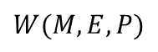
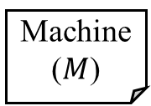
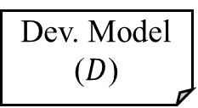
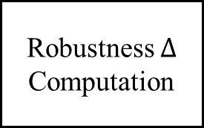
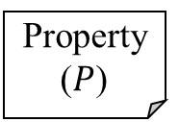
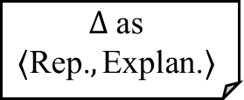
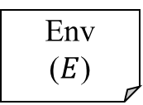
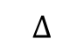
Robustness Analysis Summary
Dev. Model ($D$)
Machine ($M$)
Weakest Assumption Generation
Robustness $Δ$ Computation
Representation Traces and Explanations
Env
($E$)
$$Δ \text{as}$$
$$⟨\text{Rep}\text{.}, \text{Explan}\text{.}⟩$$
$$W(M,E,P)$$
$$Δ$$
Property ($P$)
Notes:
Mentioned there are other components can be found in the proposal and paper.

Slide 33
Robustification by Wrapper
Safety
Liveness
Observability
Controllability
Cost
Design synthesis for safety through supervisory control theory.
Multi-objective optimization for retaining liveness and minimize cost.

Slide 34
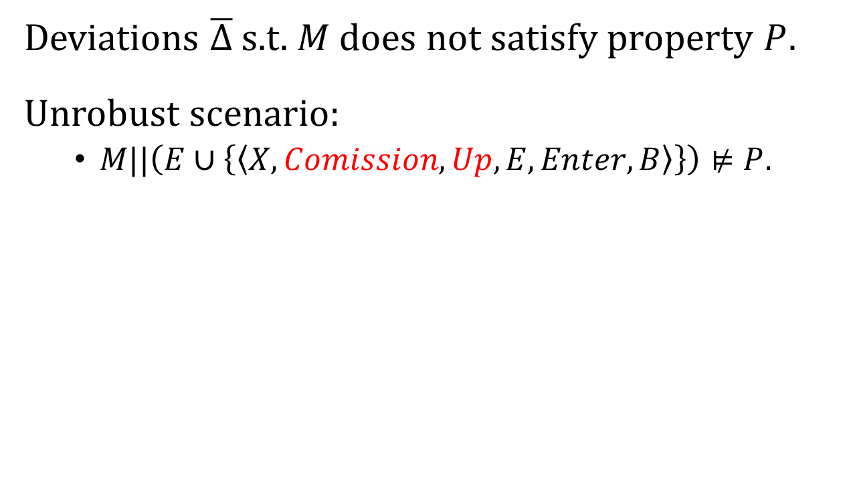
Intolerable Deviations
Select Mode
Deviations $\overline{Δ}$ s.t. $M$ does not satisfy property $P$.
Unrobust scenario:
$M||\left(E∪\left\{\left\langle X,Comission,Up,E,Enter,B\right\rangle \right\}\right)⊭P$.
Up
Go Back
X
E
Confirm Mode
Commission
Mode switching not completed yet!
Enter
Fire Beam
B
Task Complete
Transiting to

Slide 35
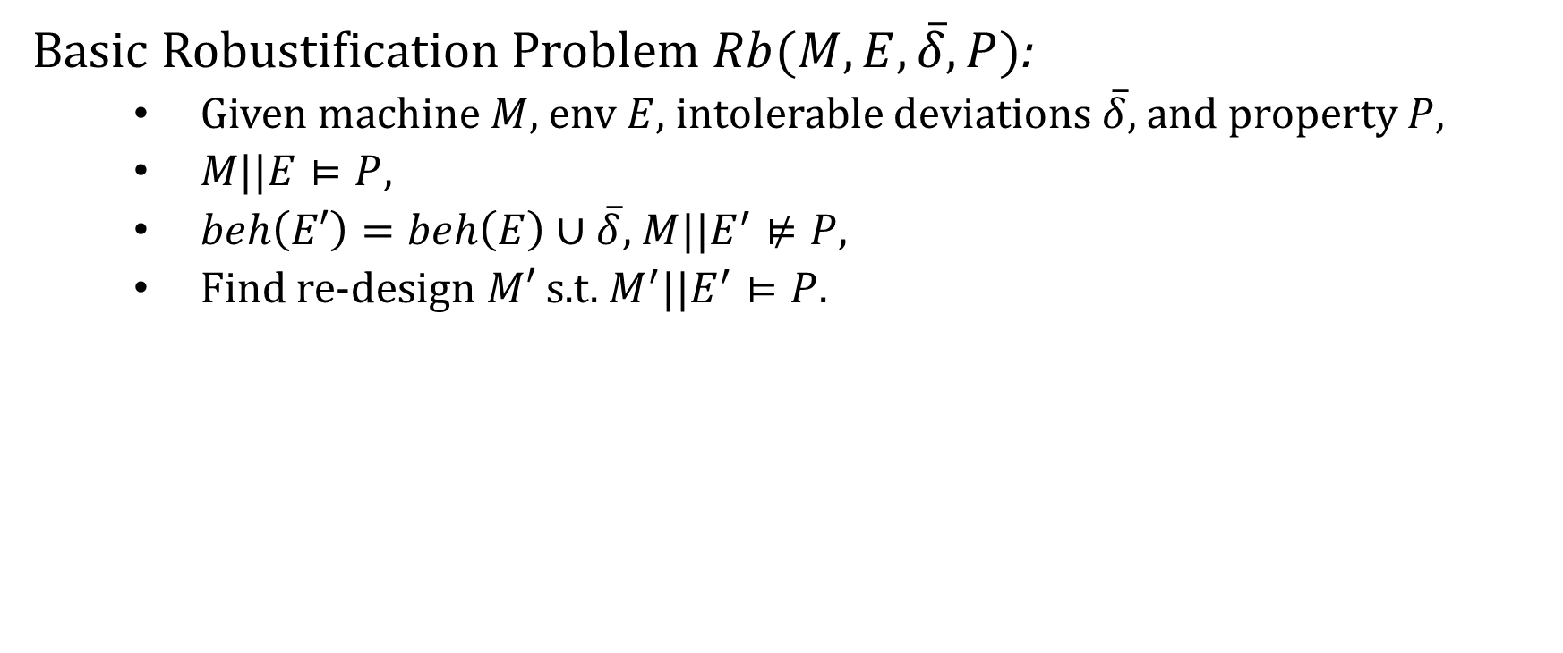
Robustification Problem
Basic Robustification Problem $Rb(M,E,\overline{δ},P)$:
Given machine $M$, env $E$, intolerable deviations $\overline{δ}$, and property $P$,
$M||E⊨P$,
$beh\left(E′\right)=beh\left(E\right)∪\overline{δ}$, $M||E^{′}⊭P$,
Find re-design $M′$ s.t. $M^{′}||E^{′}⊨P$.

Slide 36
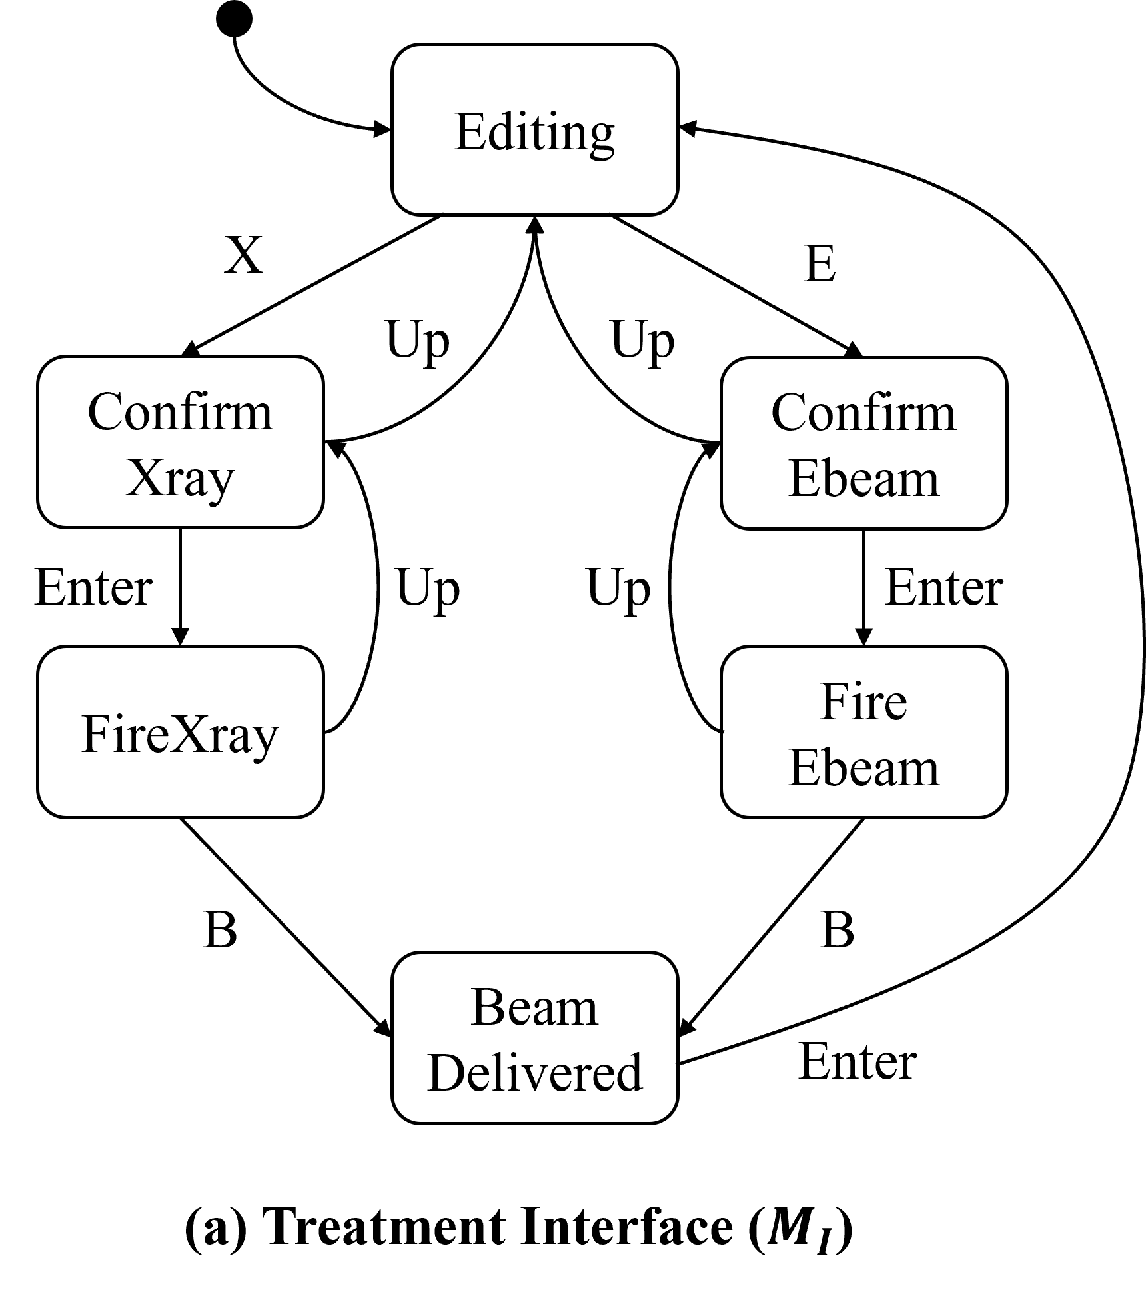
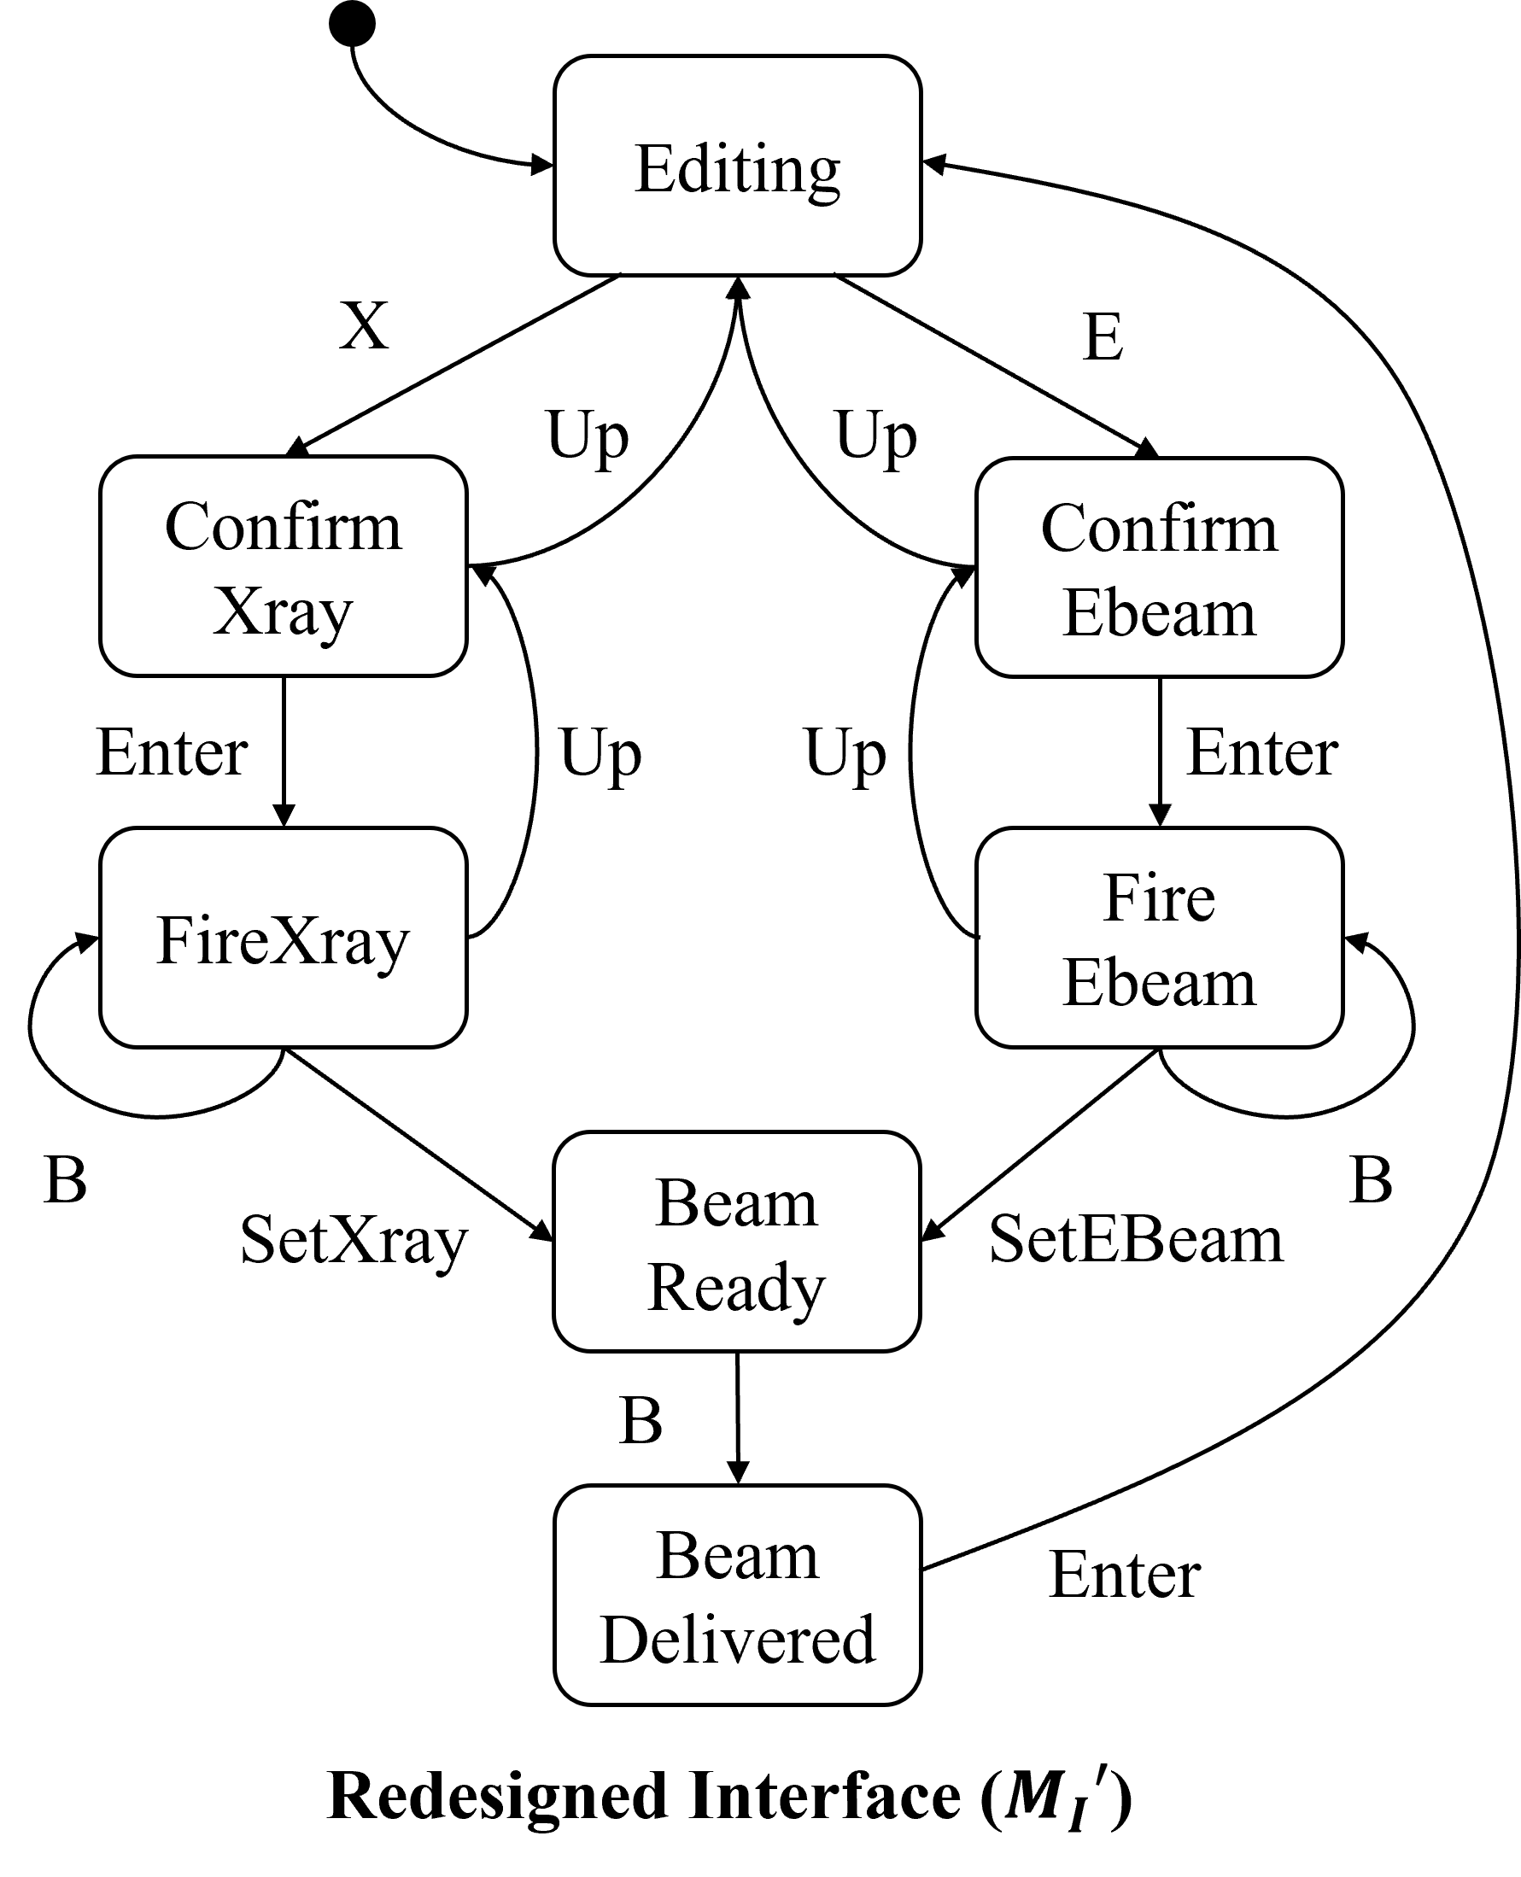
Trade-Offs between Solutions
Disable all up actions
Synchronize on mode-switching
Better liveness, but Higher cost
Lower cost, but Worse liveness

Slide 37
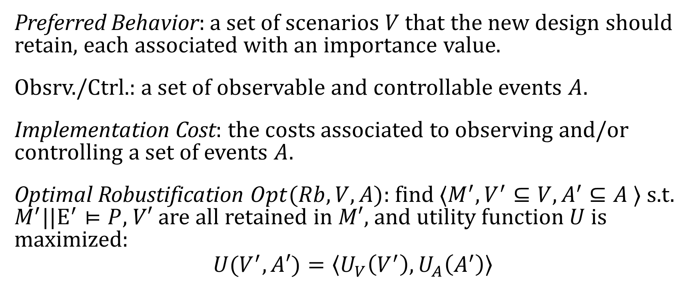
Optimal Robustification Problem
Preferred Behavior: a set of scenarios $V$ that the new design should retain, each associated with an importance value.
Obsrv./Ctrl.: a set of observable and controllable events $A$.
Implementation Cost: the costs associated to observing and/or controlling a set of events $A$.
Optimal Robustification $Opt(Rb, V,A)$: find $⟨M^{′},V^{′}⊆V,A^{′}⊆A ⟩$ s.t. $M^{′}||E^{′}⊨P$, $V′$ are all retained in $M′$, and utility function $U$ is maximized:
$$U(V^{′},A′)=\left\langle U_{V}\left(V^{′}\right),U_{A}\left(A^{′}\right)\right\rangle$$
Notes:
Include a diagram of paretol optimal; remove some text.

Slide 38
Supervisory Control Theory
Controller
Observe events in the machine and env.
Ensure the safety property by disabling events.
System
Machine
Deviated
Env.
satisfy
Property

Slide 39
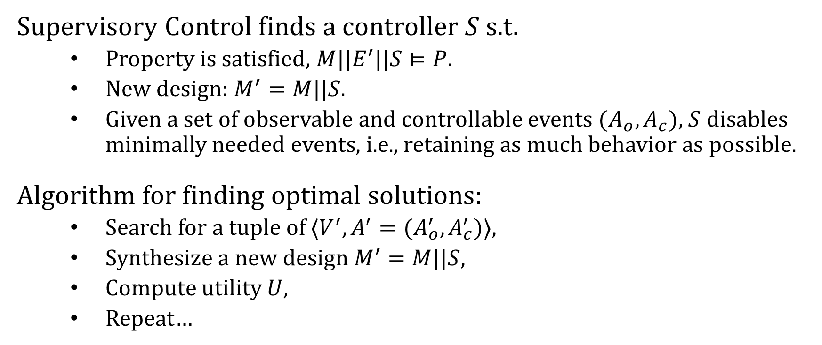
Robustification by Supervisory Control
Supervisory Control finds a controller $S$ s.t.
Property is satisfied, $M||E^{′}||S⊨P$.
New design: $M^{′}=M||S$.
Given a set of observable and controllable events $(A_{o},A_{c})$, $S$ disables minimally needed events, i.e., retaining as much behavior as possible.
Algorithm for finding optimal solutions:
Search for a tuple of $⟨V^{′},A^{′}=(A_{o}^{′},A_{c}^{′})⟩$,
Synthesize a new design $M^{′}=M||S$,
Compute utility $U$,
Repeat…

Slide 40
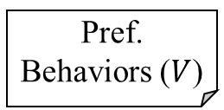

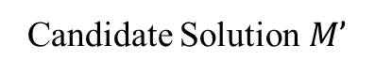
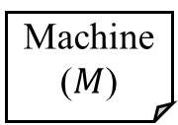




Robustification by Wrapper Summary
Machine ($M$)
Env
($E$)
Property ($P$)
$$V^{′}⊆V$$
$${(A}_{c}^{′},A_{o}^{′})⊆(A_{c},A_{o})$$
Design Optimizer
Supervisory Control Synthesis
Candidate Solution $M’$
Intolerable Dev. ($\overline{δ}$)
Pref. Behaviors ($V$)
Ctrl./Obs. Events ($A_{c},A_{o}$)
Optimal new designs $M’$

Slide 41
Ongoing Work: Robustification by Specification Weakening
Safety
Liveness
Observability
Controllability
Cost
Safety LTS and FLTL.
LTL Learning.

Slide 42

Weaken the Safety Property
A strong safety property may be too restrictive to enforce.
E.g., avoiding over-dose and under-dose
To enforce safety and retain liveness:
Observe and synchronize on both $SetXray$ and $SetEBeam$.
Might be costly.
If under-dose could be relaxed:
Observe only one of them, cheaper.

Slide 43

Challenge: How to Weaken?
LTL safety invariants in $G(φ→ψ)$:
$G\left(Xray∧Fired→SpreaderIn\right)∧G(Ebeam∧Fired→!SpreaderIn)$
Translated to a safety LTS.
LTL learning from examples:
Given positive and negative examples,
Learn an LTL that separates the examples.

Slide 44
Ongoing Work: Fortis and Evaluations
A tool implementing the proposed approaches.
Evaluations based on 5 case studies.

Slide 45

Fortis: A Tool for Robustness
Notes:
This should come earlier.

Slide 46

Evaluation Case Studies
Therac-25 radiation machine
ABP protocol
iVotronic voting machine
Oyster public transportation system
Infusion pump

Slide 47
Thank you!
Expected Contributions:
Behavioral notion of robustness w.r.t. safety based on LTS.
Robustness computation and representation approach.
Robustification approach:
Wrapper, disable events to ensure safety.
Specification weakening, weaken a safety property.
Maximizing liveness and minimizing cost.
Fortis, an implementation of the approaches, and evaluation focusing on applicability and efficiency through 5 case studies.

Slide 48

Robustness Computation Results

Slide 49

Robustification by Wrapper Results

